Slide 1
FUNDRAISING
Mindy Grinnan WRJ SE District Treasurer
WRJ SE DISTRICT
AREA DAY
NOVEMBER 7,2021

Slide 2
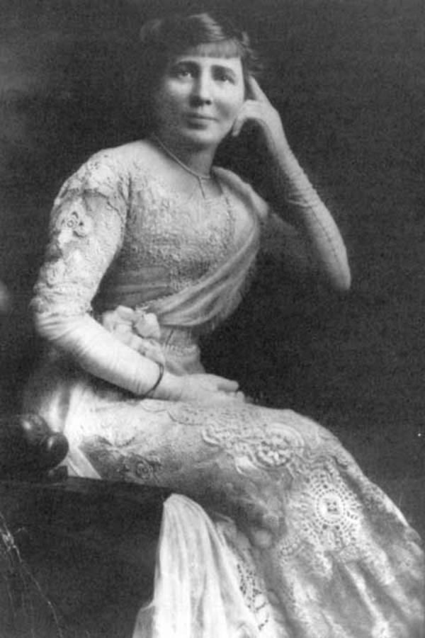
WRJ Fundraising In Our Earliest Years
In 1919, twenty-four complete scholarships funded for future rabbis.
A campaign to build a dormitory at Hebrew Union College in Cincinnati. When it opened in 1925, the dorm housed 100 students.
Carrie O. Simon, founder and President, National Federation of Temple Sisterhoods, 1913-1919

Slide 3
FUNdDraising Fundamentals
Know Your Audience
2. Have A Good Chair and Team
3. Use Themes
4. Decide the fundraising strategy
5. Get the Word Out – Word of mouth, Social Media, Think BIG
6. Know Your Technology
7. Follow-Up with Thank Yous
8. Debrief with a post-event review

Slide 4
Virtual Fundraisers
Silent Auction and Raffles | Bingo
Tours to places we can’t travel to- Israel, museums,etc. | Mahjongg, card Tournaments
Instructor-led Craft Projects, Sip ‘n Paint | Gallery tours, artist talks
Zoom Galas with honorees | Scavenger Hunts, Murder Mystery Night

Slide 5
Virtual Fundraisers
Food deliveries - Challahgrams, Shabbat Dinners, Holiday candy/cookies, Bagel Brunch-To-Go | Trivia Contest
Speakers/Performers/Magicians/Comedy | Zoom-a-Thon weekend of programs
Cooking/baking classes, cookie kits | Wine & Cheese Tasting
Virtual Seders | Online Sisterhood Cookbook

Slide 6
MURDER MYSTERY
NIGHT OF MYSTERY (VIRTUAL OR IN PERSON- DOWNLOADABLE)
A night of murder and mayhem in the old west!
A roaring 20's night of murder and the mob!
Trust us, it will be a night you will never forget!!!

Slide 7
LITTLE BLACK DRESS (LBD)
VIRTUAL OR IN PERSON
REGISTRATION ON LINE- CHARGE $36
COCKTAIL PARTY AND EVERYONE WEARS A BLACK DRESS
IF IN PERSON, EVERYONE BRINGS (Or drop off box) A BLACK DRESS TO DONATE TO A HOMELESS SHELTER
IF NOT IN PERSON, SET UP A Gift REGISTRY LIKE WEDDING REGISTRY ON AMAZON AND CLICK ON ITEMS ON A WISH LIST THAT THEY CAN PURCHASE
VIRTUAL OR IN PERSON

Slide 8
Zoom-a-Thon: Building Community, Raising Funds
full weekend of virtual programming for all ages starting Friday night through Sunday PM
sponsorship opportunities
option to order shabbat meals from a local caterer and pick up Friday afternoon
homemade challah baked in our temple kitchen by Rabbi and Administrator
102 items on silent auction
Over $100,000 raised - Denver, Colorado

Slide 9
Mah Jong Virtual Fundraiser Jacksonville, Florida
Flyer sent out inviting people to register in groups or as individuals (in person or virtual)
Rules and Game instructions sent in advance
Instructions on how to join Realmahjongg.com in advance of game sent
Entry fee was $20 and held a 50/50 raffle
Kickoff time/ ending time to send in score sheet
Prizes $100 and $200 (as an example)
Over $1000 raised and only prizes purchased

Slide 10
CAMP HARLEM VIRTUAL AUCTION
Set up Teams with various job assignments
Team to gather donations for silent auction
Team to do Social Media
Team to get sponsors
Weekly meetings to update status on assignments
Raised about $45,000 (goal was $25,000)
Door prizes picked from registrants

Slide 11
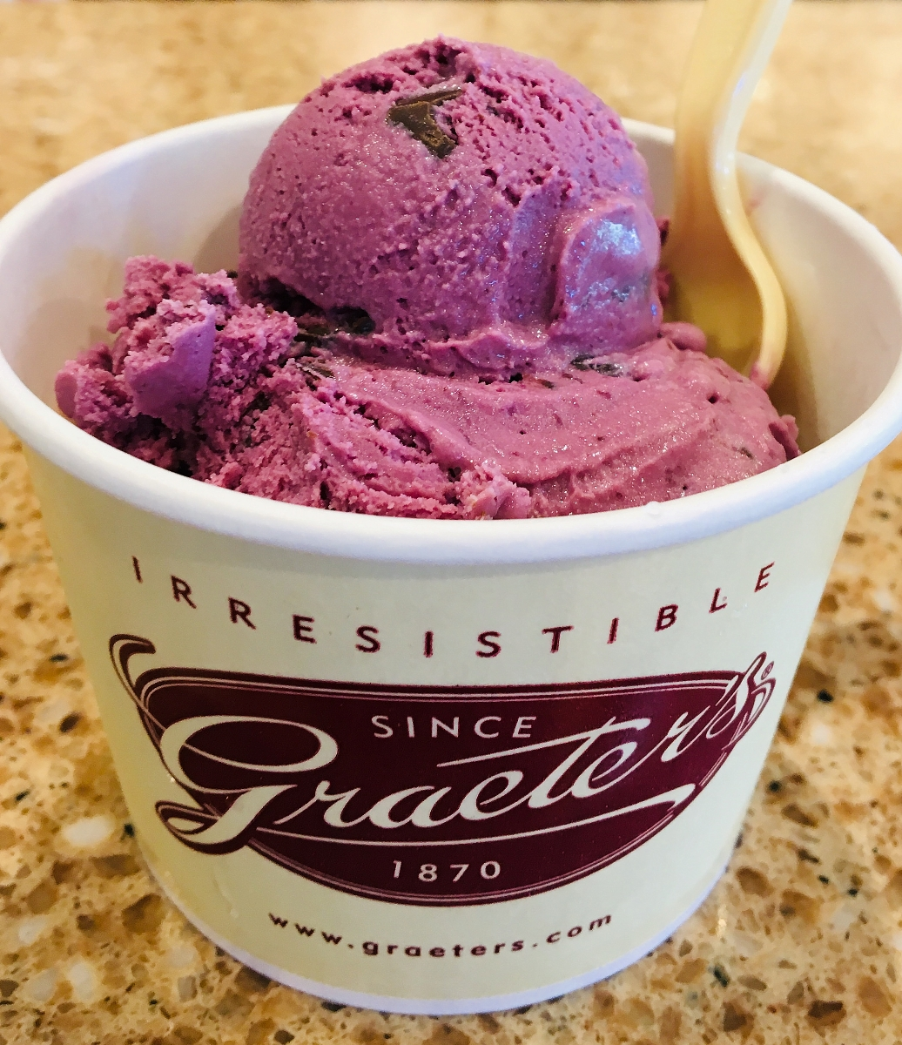
Example Of an online fundraiser-
could be coffee, challah
Support Sisterhood Right Now –FUNdraising Auction
Bid in Chat Box, E-mail, etc.
Get a Delicious Ice Cream Pack Delivered to Your door from Cincinnati’s Famous Graeter’s
6 Pints – You Choose Flavors,$80 value
$36 Starting bid, Bid in Chat
$10 increments
Fun & Delicious

Slide 12
FUNdraising References
WRJ Making the Ask and Closing the Gift presentation by Jane Karlin https://bit.ly/3pVx0tk
Yammer - Online Programming and Fundraising Groups
Rosanne Selfon, WRJ Past President - rosanne.selfon@gmail.com about Camp Harlam auction
Carol Berger - Special Events Chair, MW District, WRJ Board - Berger.carol@sbcglobal.net about speaker series
Dee Singer - Fundraising VP, Sisterhood of Adath Emanu-El deesinger3@gmail.com about Mah jongg tournament
Accelevents – Event Platform - https://www.accelevents.com/ used by WRJ for silent auction)

Slide 13
FUNdraiser References
7. ClickBid – Event Platform https://clickbidonline.com/ - Used by Camp Harlam for auction
8. Zoom-A-Thon https://ejewishphilanthropy.com/zoom-a-thon-building-community-raising-funds/
9. Real Mah Jongg - https://realmahjongg.com/ for online playing for tournaments
10. Charles Troy: Broadway Musicals and their Creators. Multimedia Presentations on many shows. Some of my favorites have been Fiddler on the Roof, Westside Story, and Wicked. Visit charlestroy.com charlestroy@comcast.net 847 757-8227
11. Gary Wenstrup: Music Historian. Multimedia Presentations on many artists. Some of my favorites have been Simon and Garfunkel, Billy Joel, and Motown. gary@wenstrup.net 773 354-0923. (Note: he will not do Saturday evening programs)

Slide 14
FUNdraiser References
12. Barry Bradford: An award-winning speaker and historian. Multimedia Presentations on Popular Culture, History, and Civil Rights. Some of my favorites have been Diana, Life and Death of the People’s Princess, Julia Child, Spy and Chef, Carl Reiner. barry@barrybradford.com. 847 351-6771
13. Dr. Leslie Goddard. An award-winning actress, author, and scholar. She does wonderful portrayals of historical women including Jackie Kennedy, Georgia O’Keeffe, and Bette Davis as well as fun programs on Remembering Route 66, the Little Black Dress, and Mid-Century Cuisine: American Food Fads form the 1940s- 1960s. www.lesliegoddard.info
14. Ellie Carlson. Ellie is a historian and performer and museum curator. She gives presentations on Ladies Underwear, Hats, and more. Among her in Among her in character portrayals are Edith the Rogue Rockefeller McCormick

Slide 15
Ellie Carlson (continued)- Mamie Eisenhower, and Phyllis Diller. We recently did the HATS program . We all wore hats on the Zoom Call and raised our teacups. elliepresents.com elliepresents@gmail.com
312 771-2400
16. Jenn Daley – WRJ Exec Commitee, for info on virtual scavenger hunts. jdsports27@hotmail.com
17. Canastajunction.com
18. TBI Skokie Sisterhood's Judaica Shop catalog:
19. Night of mystery https://nightofmystery.com
20. Goldbelly.com for food specialty shops and cross-country delivery

Slide 16
Thank you for attending!
Need to know more?
info@wrj.org
212.650.4050
www.wrj.org
Mindy Grinnan, WRJ SE District Treasurer
(904) 982-1080 mindygrinnan@yahoo.com

