Slide 1
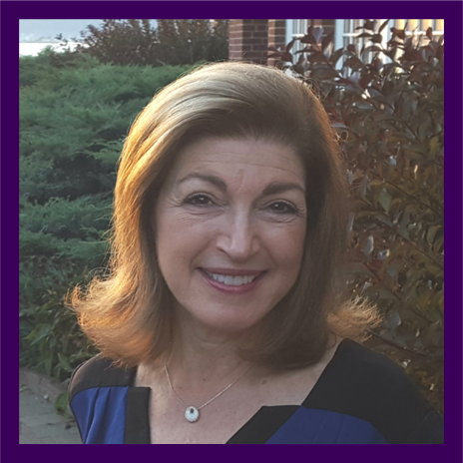
Accountability in Leadership
WRJ Southeast Convention March 17-19, 2023
Karen Sim, WRJ Fist Vice President
KAREN SIM

Slide 2

Accountability – What does that mean?
According to the dictionary accountability means:
  The fact or condition of being accountable
  According to the dictionary accountable means:
  Pertaining to a person, organization or institution
  required or expected to justify actions or decisions,
  responsible
KAREN SIM

Slide 3

As leaders we are accountable for:
Mission Statement
Goals
Finances
Community
KAREN SIM

Slide 4

WRJ Mission Statement
Women of Reform Judaism (WRJ) strengthens the voice of
women worldwide and empowers them to create caring
communities, nurture congregations, cultivate personal and
spiritual growth, and advocate for and promote progressive
Jewish values.
KAREN SIM

Slide 5

Goals
Big Goals:
Provides purpose for your organization/members
Speaks to core values
Select at least 1, no more than 3
Targeted Goals:
Programs and projects that reflect mission/values
Engagement/Social
Goals require support from:
EC/core leadership group
Board
Membership
Goals require Action Plans
KAREN SIM

Slide 6

What is an Action Plan ?
What is the goal, what needs to be done
What resources are needed to accomplish that goal
Who is going to work on this
Timeline, stages, phases
Evaluation
KAREN SIM

Slide 7
Action Plan Template
Goal or Task | Expected Outcome | Who Will Do It? | Resources Required | Timeframe (By when?)
Listening Campaign for Interest, Membership | Greater understanding of constituency, More participation, activities that reflect the needs of the group | Specific committees Listening campaign – tech. facilitators, follow up team Programming Marketing and PR | Time volunteers Advertising/ Marketing | Phase 1 Phase 2 Phase 3
 |  | EVALUATION
KAREN SIM

Slide 8

Why Use an Action Plan?
KAREN SIM
Provides structure to our work
Keeps us moving forward
Allows for revision and evaluation

Slide 9

Financial Accountability
Budget - reflects mission and values
Financial Support for Congregation – reflects values
Membership – ethical stewardship
KAREN SIM

Slide 10

Accountable to our Community
Nurture environment where people feel:
included
informed
valued
comfortable/safe
social
participation is enjoyable
KAREN SIM
Nurture environment where people feel:

Slide 11
Accountable to our Community
Feel empowered to:
Acknowledge what we cannot do
Make mistakes
Apologize

Slide 12
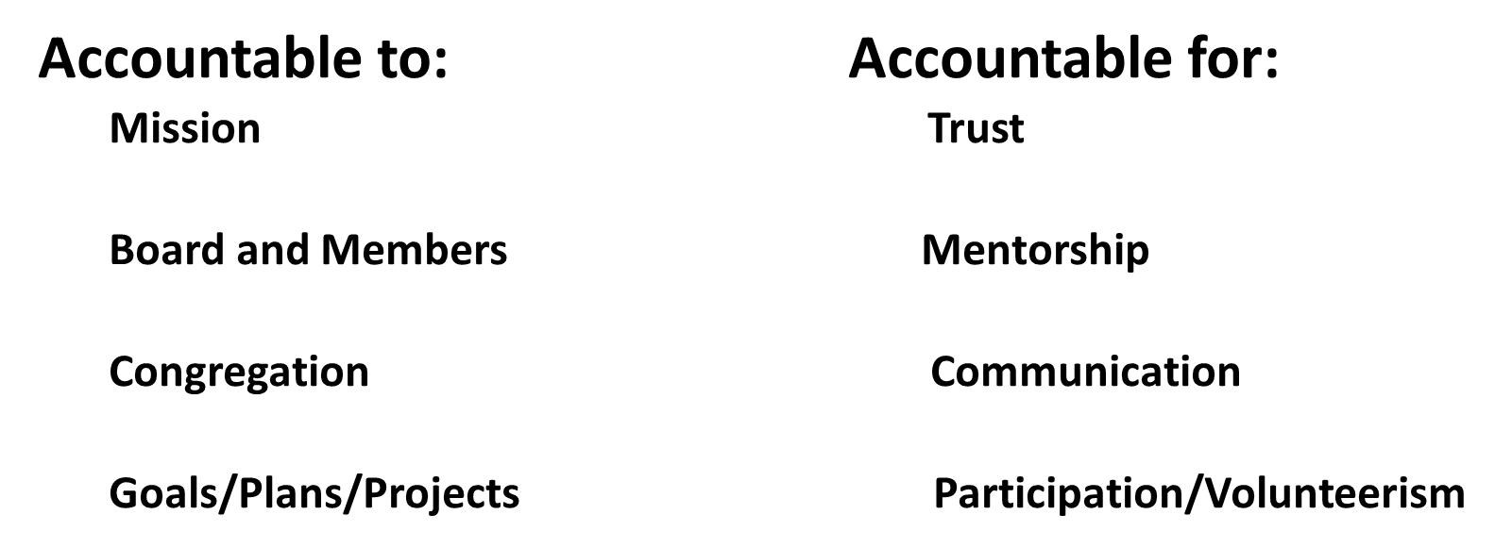
Accountability as “Servant Leadership”
KAREN SIM

Slide 13
Thank you
Karen Sim
karen.schiffer.sim@gmail.com
513-520-5688
Questions ?
KAREN SIM

